Slide 1
LOGO
ABOUT
SERVICES
Chat with Us
SWIFT.

Slide 2
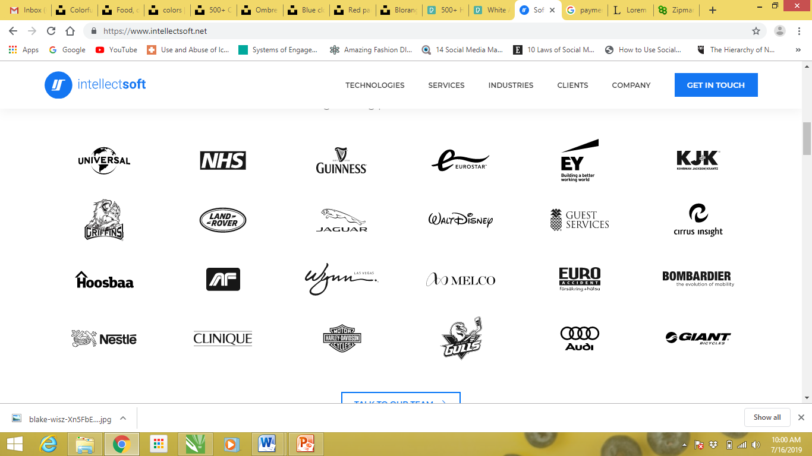
WHO WE ARE?
We define technology with innovation, quality and versatility. Our digital solutions are designed to provide a secure business environment in an effective and efficient manner.
Our key strength is our ability to maintain the highest levels of security certifications across platforms. Our full-stack software developers are proficient in handling the entire lifecycle of your product, right from planning & strategy, UI/UX, app development, quality analysis testing to final product deployment. We deliver customized, scalable solutions to develop secure, high-end web and mobile solutions.
CHAT WITH US
Our payment solutions are trusted by large corporations AROUND THE WORLD

Slide 3
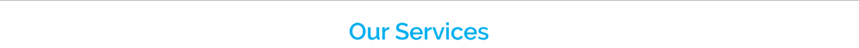
Here are the services that we offer for businesses that are looking for payment and FinTech solutions. Go ahead and explore what we can do for you.
Web Development
We deliver tangible results with our client focused and customer-centric approach. Our web solutions are designed to help enterprises and customers securely navigate through the digital terrain.
Mobile Development
Our extensive expertise and in-depth technical knowhow help us develop feature packed native mobile applications that are high performing, secure, digitally transformative
Cloud & Integration
Our system integration experts design solutions to make enterprises efficient as well as better connected. We deliver high-end business outcomes with the right blend of innovation, process and IT stacks.

Slide 4
We Invest in Emerging Tech
We as a team at Fineotech, have experience in building disruptive solutions since last 10 years and now are ready to challenge ourselves with solutions trending in the emerging technologies. We are now aiming at building solutions that are not just Smart, but Swift & Secure using the best in breed technology.
We are engaging in opportunities fields and concepts of the future.
Let’s explore these possibilities together
Internet of Things I Machine Learning I Big Data I Business Intelligence

Slide 5
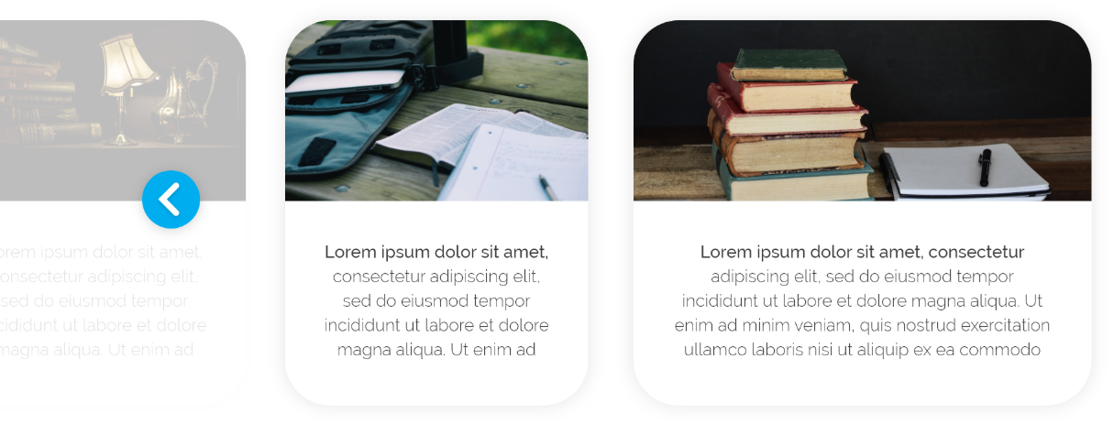
Highlight of Our Key Projects
Take a look at some of our projects where we have worked along with the clients to bring their Idea to Reality. From Payment Processing Apps, ERP system to Community Loyalty and Machine Learning in Fineotech, we have done some interesting work.

Slide 6
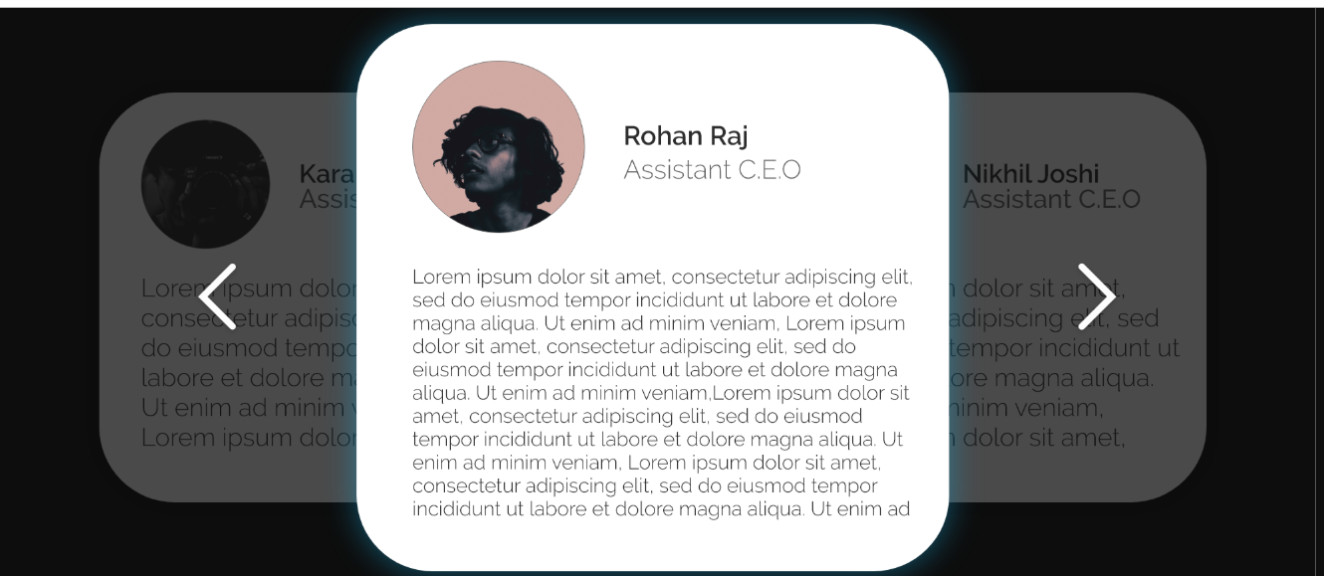
Our Team
This is the force behind Fineotech who ensure that solutions built function swiftly, are highly secure and can be scaled to meet client objectives.

Slide 7
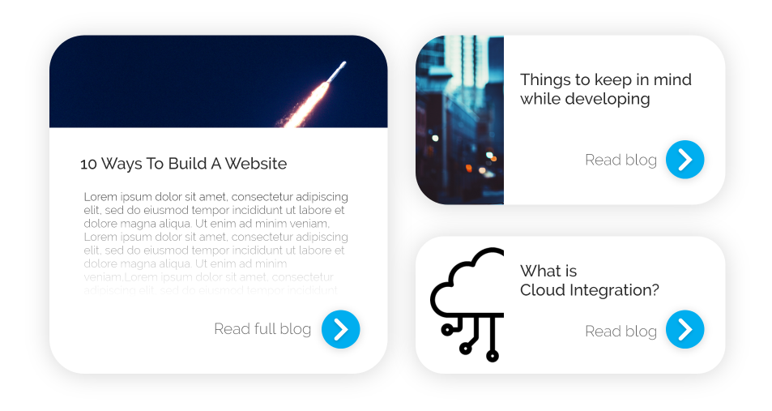
Our Blog
Learn about the latest in the technology industry, FinTech and BFSI (Full Form) from the experts and curators at Fineotech. Also, see updates about our new venture, products and projects.

